Slide 1
P1 VA/VE Training Material

Slide 2


Lean-VA/VE Process Overview –
Enterprise Improvement Program (P1-EIP)
Phase & Timeline
Pipeline
Events & Tools
Pipeline
Bi-weekly Event
Component Complexity Reduction
Product Line Standardization
Quality
Phase 0
Convert Initial Tooling to Volume Production
Commodity Standardization
VSM / process mapping
ID waste, RMA, Field Issue
Component tech review
Sourcing review,
Standardization, Tooling review, Safety & ROHS
Effort /benefit analysis (Pugh matrix), Cost & revenue cube
Project Plan
Process Excellence
Mfg Material Standardization
Product Line re-fresh (EOL)
Weigh & Qualify
3-4 weeks
Phase I
Weigh & Qualify
Refine & Select
2-3 weeks
Phase II
Refine & Select
Product line evaluation
Functionality / standization analysis, Complexity reduction, Internal approval
Order samples , Initial customer approval
ACE request, Plan sample order build
Validate Changes
6-10 weeks
Phase III
Validate Changes
Approve
3-4 weeks
Design & Process validation
Kick-off tooling, Profit/ revenue growth bowler
Phase IV
Approve
Final customer approval
Production trial runs
Ramp-Up
8-12 weeks
Phase V
Ramp-Up
Production ramp-up
Monitor/track bowler
Quality monitoring
Lessons learned
Close project
Team recognition

Slide 3
EIP-VA/VE Event Planning
I. Phase 0- Project Selection from Pipeline And Target Setting Process
II. Pre-Event Work
III. Event Activities-Phase 1 & II
VOC & Customer Value Ratio Analysis
VOC Analysis
Complexity Reduction Analysis
Profitability Analysis
Cost and Revenue Data Collection Across Plants
Function / Cost Analysis
Project Prioritization
Sub-System Boundary Mapping
Competitive Analysis
Preliminary Proposals
Cost Based Project Selection
Supplier Pre-Work Assignment
VA/VE Idea Generation
Preliminary Complexity Analysis
Function Cost Analysis
Post VA/VE Event- Phase III – Phase V

Slide 4
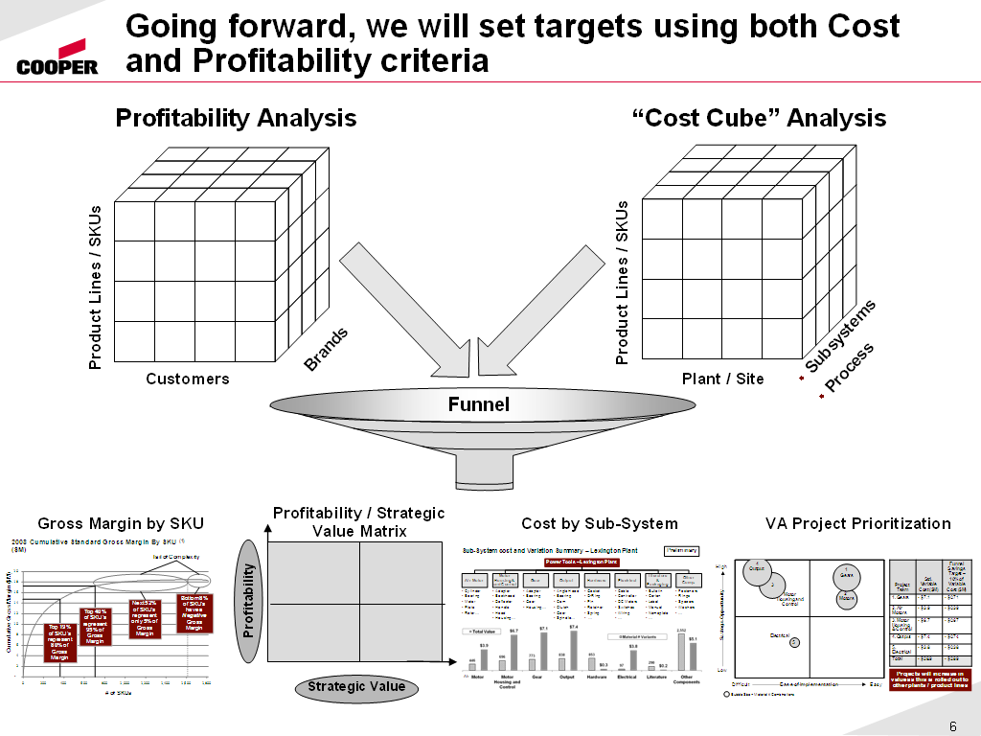

Slide 5
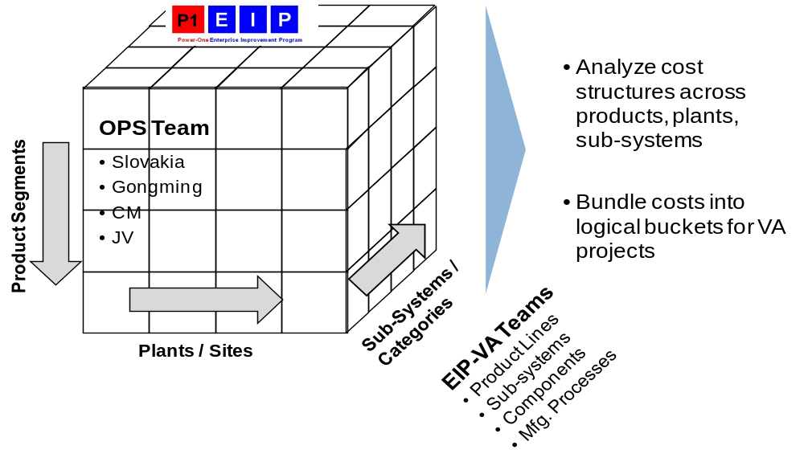
Revenue & Cost Data Collection
Product Lines
NPS
DC/DC BMP
ABC
XYZ
AXY
SSN
ABC
XYZ
BMP
Etc
NPS
ABC
XYZ
BMP
etc

Slide 6
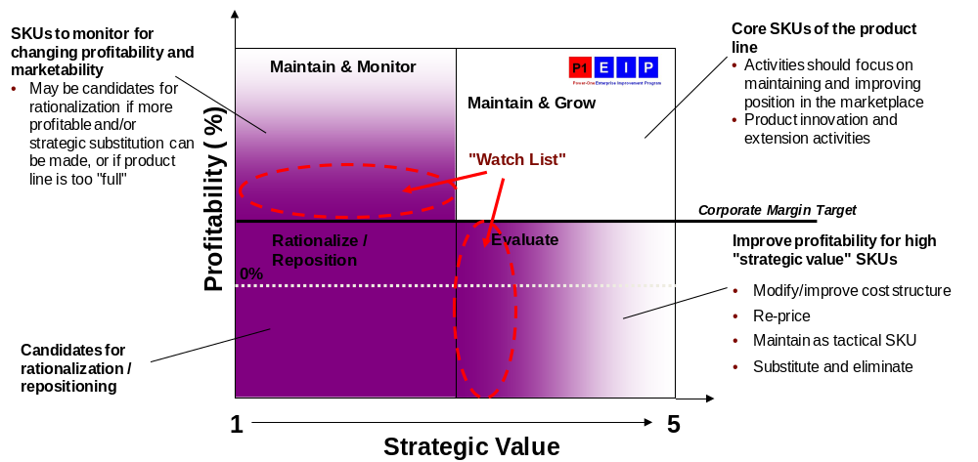
Strategic Value Matrix

Slide 7
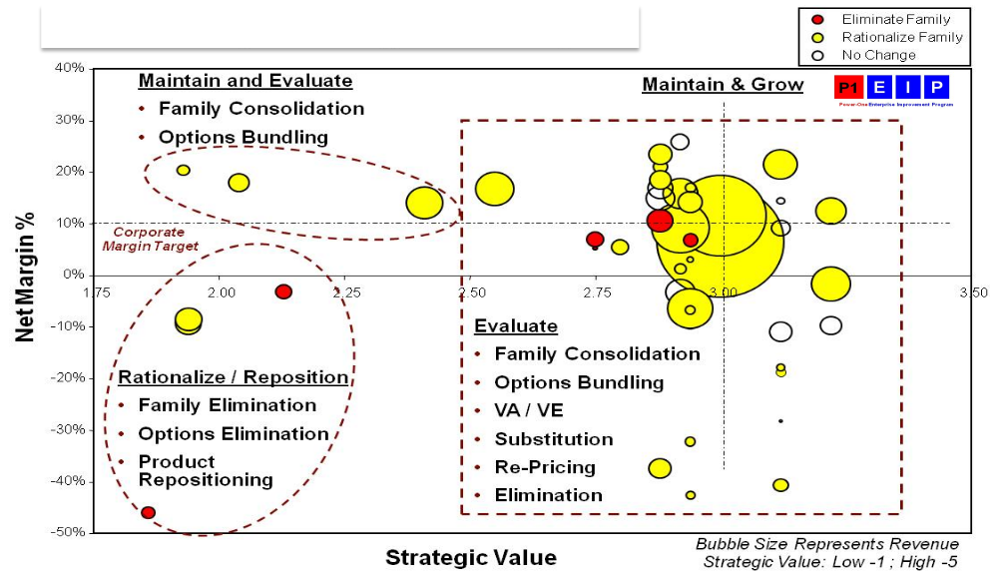
Strategic Value Matrix
Consider conducting similar analysis by SKU within a product series. Y-axis can be revenue as 2013 GDP is growth focus and X-axis can be margin $.

Slide 8
Template/training Needed ASAP
Cost cube analysis-let’s start with lab, OH, product material, packaging cost (incoming and FG), freight cost, MOQ (FG & component), inventory
Functionality analysis.
Component & FG complexity analysis
Component & FG Standardization
Material value analysis-does it make sense to buy 0.1 gm aluminum stamped part for $1?
Supply Mapping/Vendor consolidation
Prioritization ideas
Material planning to minimize excess

